Slide 1
Chapter 1
T.Y.B.SC.(COMPUTER SCIENCE)
CS-334 INTERNET PROGRAMMING -I
Introduction to Web Techniques
Dr. Savita Mohurle

Slide 2

Topics covered
Http basics
Web server & Web browser
Introduction to PHP
Lexical structure of PHP

Slide 3
HTTP Basics
HTTP is Hyper Text Transfer Protocol.
Communication between client computers and web servers is done by sending HTTP Requests and receiving HTTP Responses.
The Hypertext Transfer Protocol (HTTP) is the foundation of the World Wide Web, and is used to load web pages using hypertext links.
WWW is about communication between web clients and servers.

Slide 4
World Wide Web
The World Wide Web is about communication between web clients and web servers.
Clients are often browsers (Chrome, Edge, Safari), but they can be any type of program or device.
Servers are most often computers in the cloud.
Communication between client computers and web servers is done by sending HTTP Requests and receiving HTTP Responses

Slide 5
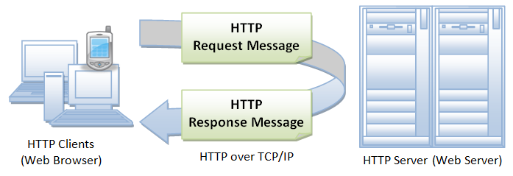
HTTP Request / Response

Slide 6
http headers
HTTP headers let the client and the server pass additional information with an HTTP request or response.
HTTP header fields provide required information about the request or response, or about the object sent in the message body.
An HTTP header consists of its case-insensitive name followed by a colon (:), then by its value.
There are four types of HTTP message headers:
General-header
Client Request-header
Server Response-header
Entity-header

Slide 7
HTTP Request / Response
A client (a browser) sends an HTTP request to the web
An web server receives the request
The server runs an application to process the request
The server returns an HTTP response (output) to the browser
The client (the browser) receives the response
All browsers
have
XMLHttpRequest object
Suppose javascript object
XHR – is used to request and receive data

Slide 8
How is request/response circle?

Slide 9
REQUEST/REPONSE HEADER
REQUEST
GET /abc.htm HTTP/1.1
User-Agent: Mozilla/4.0 (compatible; MSIE5.01; Windows NT)
Host: www.myprogramming.com (server)
Accept-Language: en-us
Accept-Encoding: gzip, deflate
Connection: Keep-Alive
RESPONSE
HTTP/5 200 OK
Date: Mon, 27 Jun 2020 12:28:53 GMT
Server: Apache/2.2.14 (Win32) www.myprogramming.com
Last-Modified: Wed, 22 Jun 2020 19:15:56 GMT
Content-Length: 88
Content-Type: text/html
Connection: Closed

Slide 10
Response header
<?php function get_contents()
{ file_get_contents("http://php.net"); var_dump($http_response_header); } get_contents(); var_dump($http_response_header);
?>

Slide 11
Output response header
array(9) {
[0]=> string(15) "HTTP/1.1 200 OK"
[1]=> string(35) "Date: Sat, 12 Apr 2008 17:30:38 GMT"
[2]=> string(29) "Server: Apache/2.2.3 (CentOS)“
[3]=> string(44) "Last-Modified: Tue, 15 Nov 2005 13:24:10 GMT"
[4]=> string(27) "ETag: "280100-1b6-80bfd280""
[5]=> string(20) "Accept-Ranges: bytes"
[6]=> string(19) "Content-Length: 438"
[7]=> string(17) "Connection: close"
[8]=> string(38) "Content-Type: text/html; charset=UTF-8"
}
NULL

Slide 12
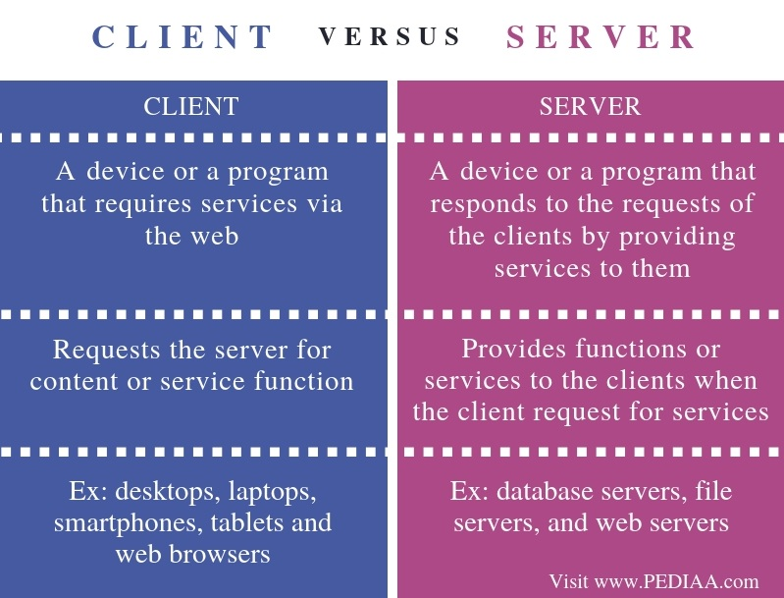

Slide 13
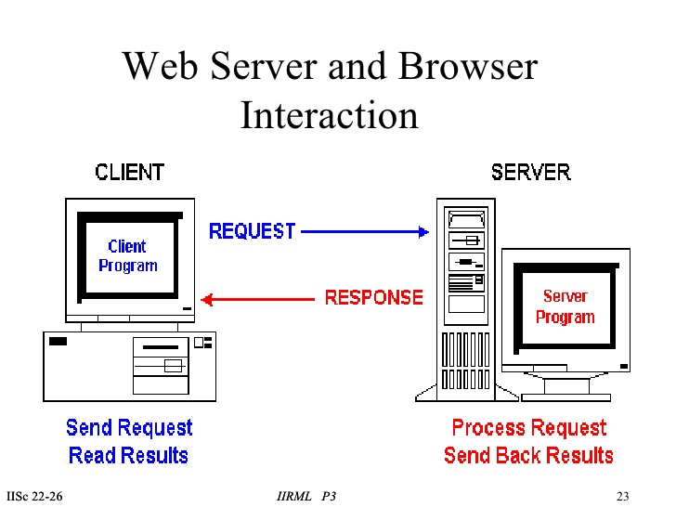
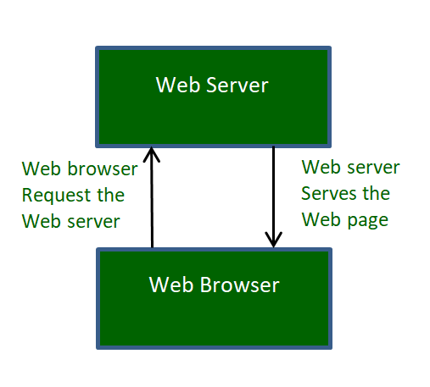
Web Server & Web Browser
Web Browser is an Application program that displays a World wide web document. It usually uses the internet service to access the document.
Web server is a program or the computer that provide services to other programs called client. The Web browser requests the server for the web documents and services.

Slide 14
Php & Php files
An acronym for "PHP: Hypertext Preprocessor“
A server scripting language, and a powerful tool for making dynamic and interactive Web pages.
A widely-used, open source scripting language
Are executed on the server
Free to download and use
PHP files can contain text, HTML, CSS, JavaScript, and PHP code
PHP code is executed on the server, and the result is returned to the browser as plain HTML
PHP files have extension ".php“

Slide 15
FEATURES OF PHP
Generate dynamic page content
Create, open, read, write, delete, and close files on the server
Collect form data
Send and receive cookies
Add, delete, modify data in your database
Used to control user-access
Encrypt data

Slide 16
LEXICAL STRUCTURE
The lexical structure of a programming language is the set of basic rules that governs how you write programs in that language.
It is the lowest-level syntax of the language and specifies such things as what variable names look like, what characters are used for comments, and how program statements are separated from each other.
A source code of a PHP script consists of tokens. Tokens are atomic code elements.
PHP language, has comments, variables, literals, operators, delimiters, and keywords A source code of a PHP script consists of tokens.

Slide 17
LEXICAL STRUCTURE – php comments
Comments are used by humans to clarify the source code.
All comments in PHP follow the # character.
Ex: <?php
# comments.php
# Author Jan Bodnar
# ZetCode 2016
echo "This is comments.php script\n";
?>
Everything that follows the # character is ignored by the
PHP Interpreter.

Slide 18
LEXICAL STRUCTURE – php comments
Single line comment
Ex: // comments.php
// author Jan Bodnar
// ZetCode 2016
Multi -line comment
Ex: /* comments.php author Jan Bodnar ZetCode 2016 */
PHP also recognizes the comments from the C
language.

Slide 19
LEXICAL STRUCTURE – php white spaces
White space in PHP is used to separate tokens in PHP source file.
It is used to improve the readability of the source code.
Ex: public $isRunning;
White spaces are required in some places; for example between the access specifier and the variable name.
In other places, it is forbidden. It cannot be present in variable identifiers.
Ex: $a=1;
$b = 2;
$c = 3;

Slide 20
LEXICAL STRUCTURE – php white spaces
The amount of space put between tokens is irrelevant for the PHP interpreter.
It is based on the preferences and the style of a programmer.
Ex: $a = 1;
$b = 2; $c = 3;
$d =
4;
We can put two statements into one line.
Or one statement into three lines.
However, source code should be readable for humans. There are accepted standards of how to lay out your source code.

Slide 21
LEXICAL STRUCTURE – php white spaces
A semicolon is used to mark the end of a statement in PHP.
It is mandatory.
Ex: $a = 34;
$b = $a * 34 - 34;
echo $a;
Here we have three different PHP statements.
The first is an assignment. It puts a value into the $a variable.
The second one is an expression. The expression is evaluated and the output is given to the $b variable.
The third one is a command. It prints the $a variable.

Slide 22
LEXICAL STRUCTURE – php Variables
A variable is an identifier, which holds a value.
In PHP language, a variable can hold a string, a number, or various objects like a function or a class.
Variables can be assigned different values over time.
Variables in PHP consist of the $ character, called a sigil, and a label.
A label can be created from alphanumeric characters and an underscore _ character.
A variable cannot begin with a number.
The PHP interpreter can then distinguish between a number and a variable more easily.

Slide 23
LEXICAL STRUCTURE – php Variables
Valid PHP identifiers.
Ex: $Value
$value2
$company_name
Invalid PHP identifiers
Ex: $12Val
$exx$
$first-name
The variables are case sensitive.
This means that $Price, $price, and $PRICE are
three different identifiers.

Slide 24
LEXICAL STRUCTURE – php Variables
<?php
$number = 10;
$Number = 11;
$NUMBER = 12;
echo $number, $Number, $NUMBER;
echo "\n";
?>
Output of the script: 101112

Slide 25
LEXICAL STRUCTURE – php constants
A constant is an identifier for a value which cannot change during the execution of the script.
By convention, constant identifiers are always uppercase.
<?php
define("SIZE", 300);
define("EDGE", 100);
#SIZE = 100;
echo SIZE;
echo EDGE;
echo "\n";
?>
Note: Constants differ from variables; we cannot assign a different value to an existing constant. The script will fail if we uncomment the line. Constants do not use the dollar sigil character.
Output of the script: 300100

Slide 26
LEXICAL STRUCTURE – php literals
A literal is any notation for representing a value within the PHP source code.
Technically, a literal is assigned a value at compile time, while a variable is assigned at runtime.
Ex: $age = 29;
$nationality = "Indian";
Here we assign two literals to variables. Number 29 and string "Indian" are literals.

Slide 27
LEXICAL STRUCTURE – php literals
<?php
$name1 = “Anshuman";
$age1 = 7;
$name2 = “Saksham";
$age2 = 5;
echo “Rohan 34\n";
echo “Rahul 22\n";
echo $name1, $age1, "\n";
echo $name2, $age2, "\n";
?>
Note : If we do not assign a literal to a variable, there is no way how we can work with it—it is dropped.
Output of the script: Rohan 34
Rahul 22
Anshuman 7
Saksham 5

Slide 28
LEXICAL STRUCTURE – php operators
An operator is a symbol used to perform an action on some value.
+ | - | * | / | ** | ++
-- | ?: | ?? | = | += | -=
*= | /= | .= | %= | == | !=
=== | !== | <> | >< | >= | <=
<=> | && | || | !xor | or | &
^ | | | ~ | . | << | >>

Slide 29
LEXICAL STRUCTURE – php delimiters
A delimiter is a sequence of one or more characters used to specify the boundary between separate, independent regions in plain text or other data stream.
Ex: $a = "PHP";
$b = 'Java';
The single and double characters are used to mark the beginning and the end of a string.

Slide 30
LEXICAL STRUCTURE – php keywords & constructs
A keyword is a reserved word in the PHP programming language.
Keywords are used to perform a specific task in a computer program; for example, print a value, do repetitive tasks, or perform logical operations.
A programmer cannot use a keyword as an ordinary variable.
Other language constructs.

Slide 31
LEXICAL STRUCTURE – php keywords
abstract | and | as | array() | break
case | catch | class | clone | const
continue | declare | default | do | else
elseif | enddecalre | endfor | endforeach | endif
endswitch | endwhile | extends | final | for
foreach | function | global | goto | if
implement | interface | instanceof | namespace | new
or | private | protected | public | Static
switch | throw | try | use | Var
while | xor | yield | yield from

Slide 32
LEXICAL STRUCTURE – php constructs
die() | echo() | empty() | exit() | eval()
include() | include_once() | isset() | list() | require()
require_once() |  | return() | print() | unset()

Slide 34
THANK YOU

